Slide 1



15 June, 2024
PVZ-
DEEPTRY
OOP-Project
Advisor:
Prof. Tran Thanh Tung

Slide 2



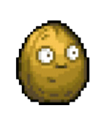
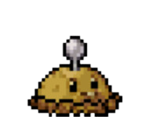
Phung Huy Quang
ITITWE22145
Do Minh Duy
ITITSB22029
TEAM MEMBERS
Phan Minh An
ITITSB22028
Luong An Khang
ITITWE22140

Slide 3
1.
2.
Introduction
Gameplay
CONTENT
3.
4
Demo
Software requirement
5.
6.
UML/Class Diagram
Conclusion

Slide 4
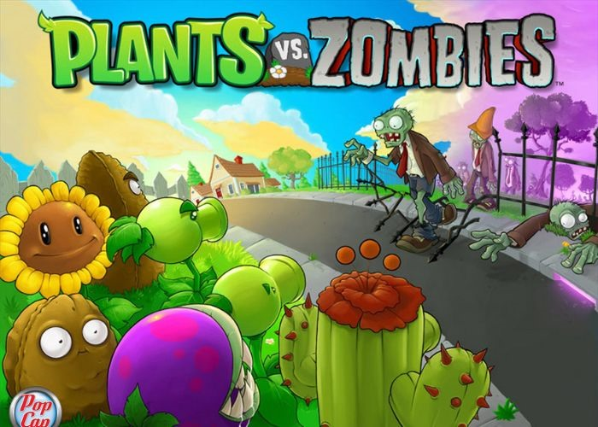

INTRODUCTION
In our game, we implemented a simplified version of the "Plants vs. Zombie" game by applying OOP principles such as encapsulation, inheritance, and polymorphism to ensure the code is modular and maintainable. Besides, we also create an engaging and interactive game experience.
We added some features in the game:
- Skip the starting levels for faster accessibility.
- Remove the lawn mowers (harder gameplay).
- Add new zombie: “Brickhead”.

Slide 5
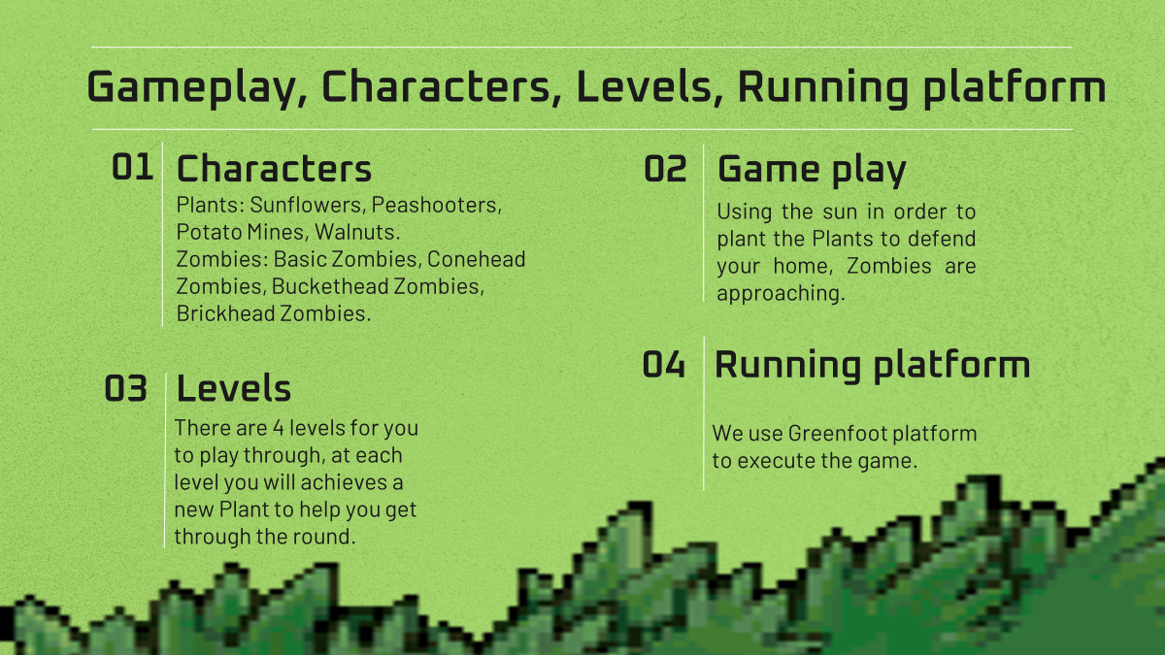


Slide 6

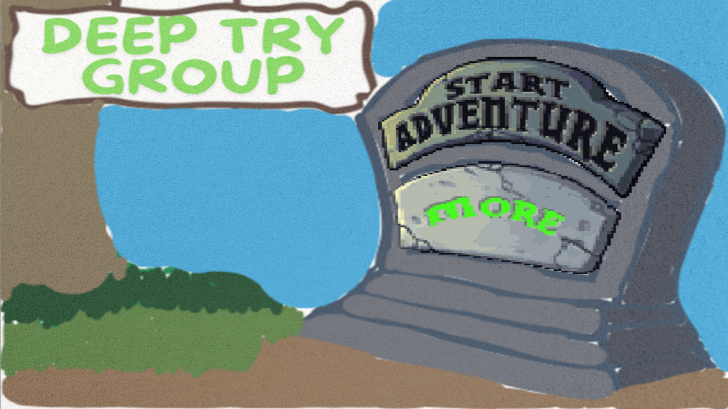

DEMO

Slide 7




Software
Requirement
Canva/Photoshop
UML making
Creating background
Editing Image
GreenFoot and VSCode
Execute game
Creating game elements
Github
Commiting Work

Slide 8

UML/CLASS DIAGRAM

Slide 9
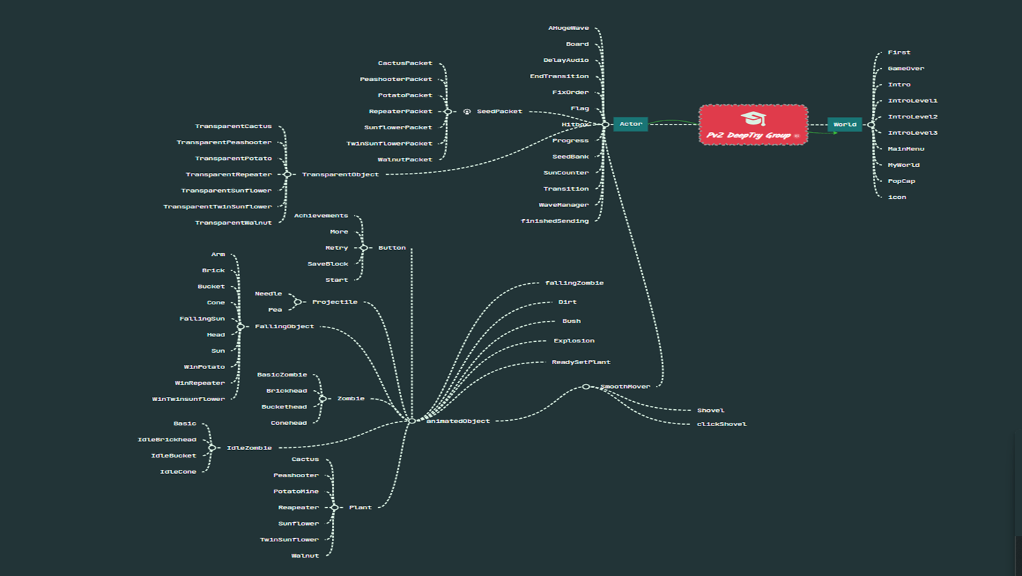

Slide 10
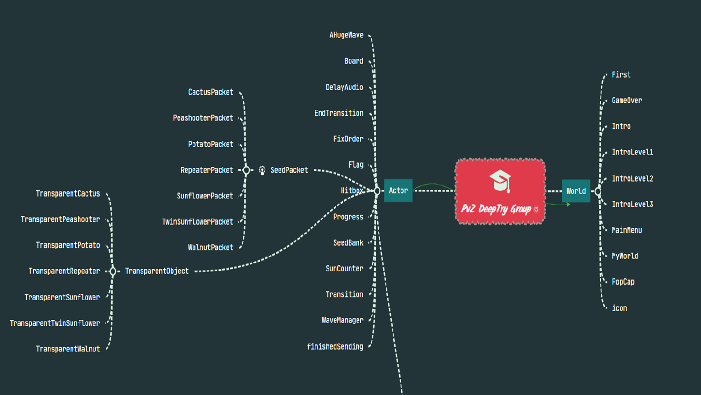

Slide 11
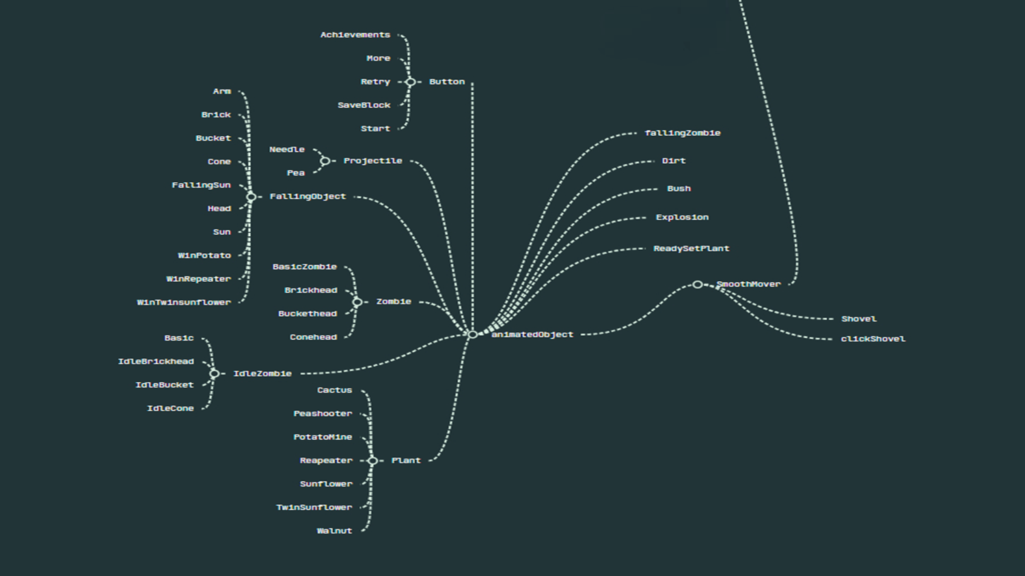

Slide 12
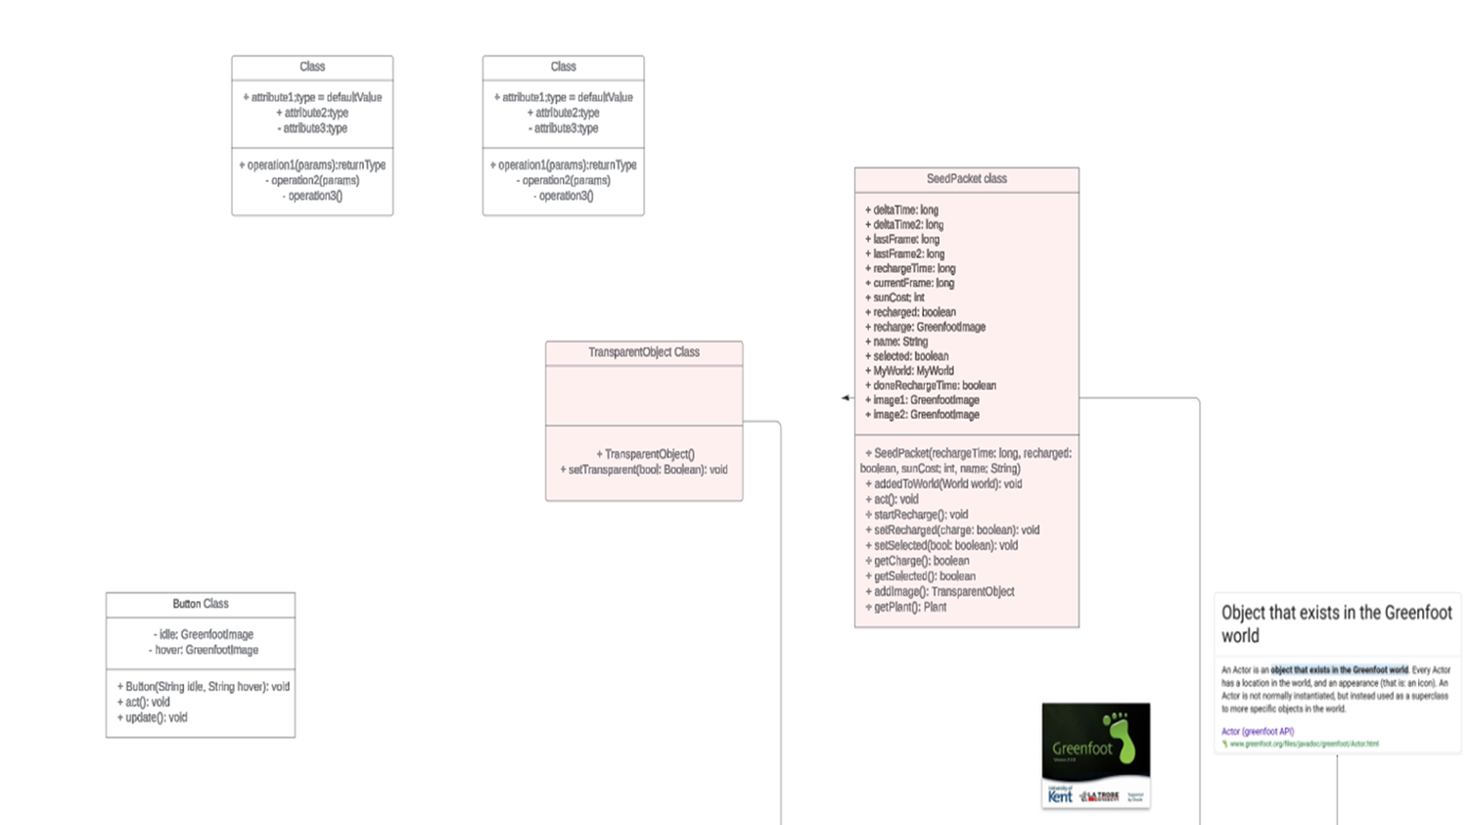

Slide 13
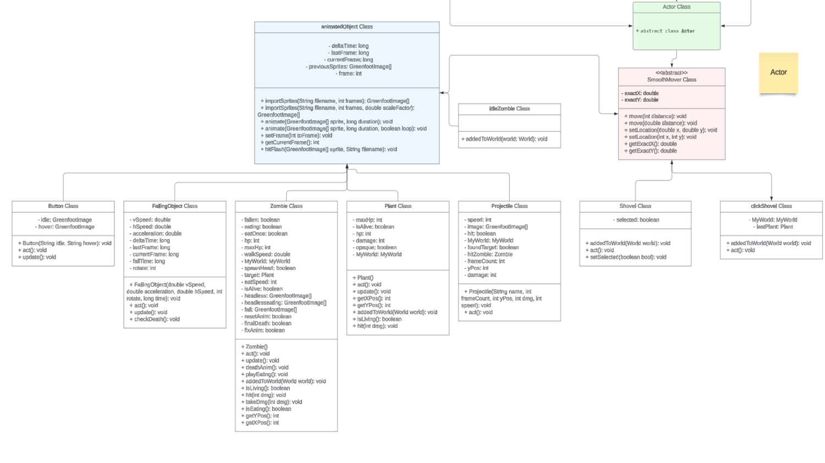

Slide 14
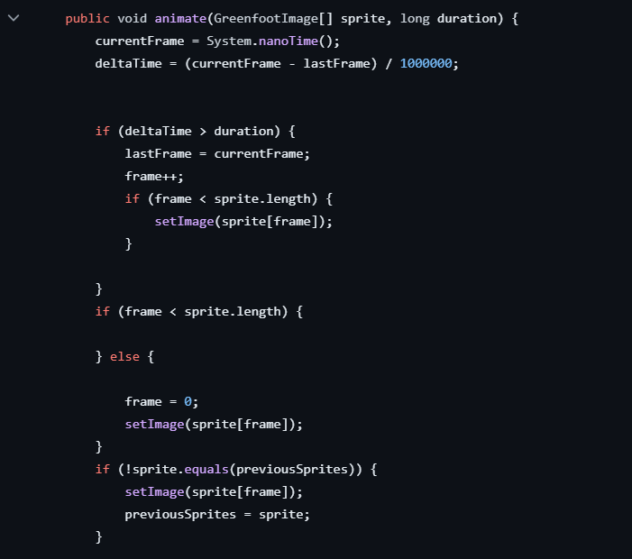
HOW IT WORK
ANIMATE MECHANISM

Slide 15
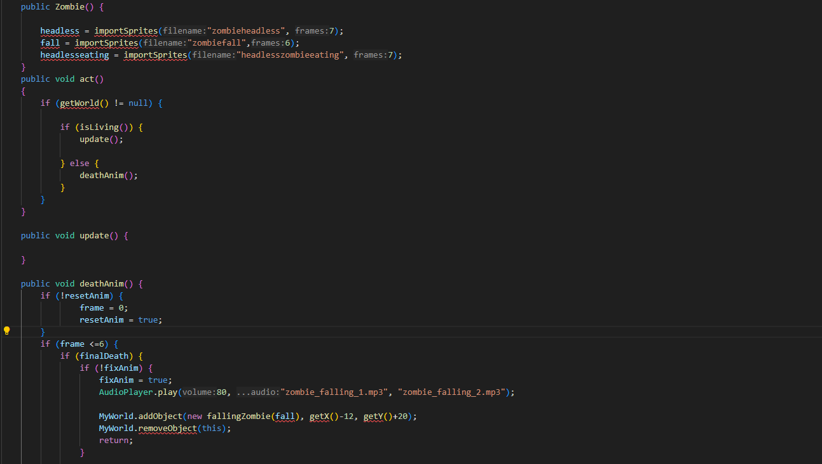
HOW IT WORK
ZOMBIES MECHANISM

Slide 16
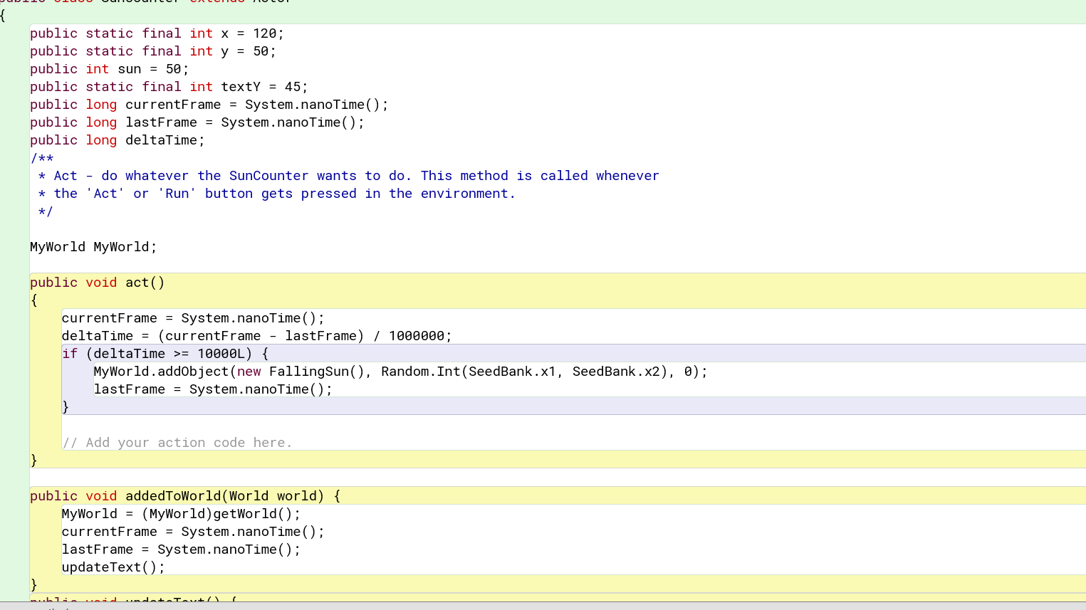
HOW IT WORK
SUN COUNTER MECHANISM

Slide 17
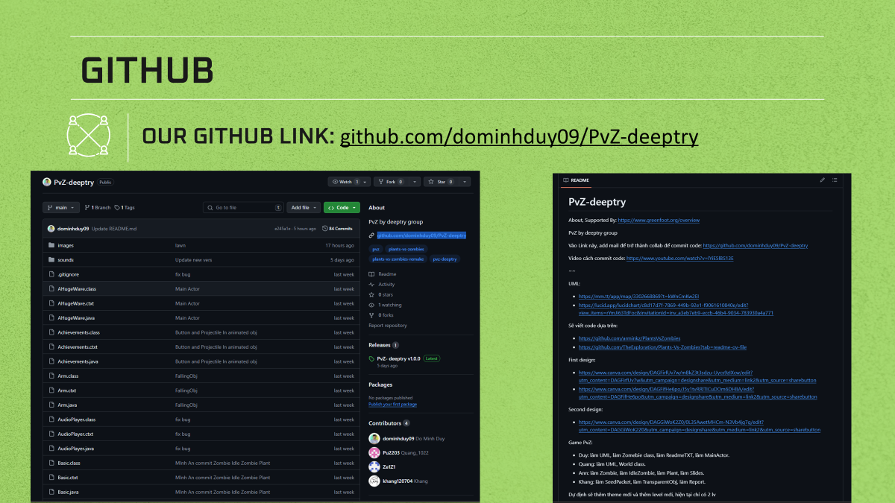

Slide 18
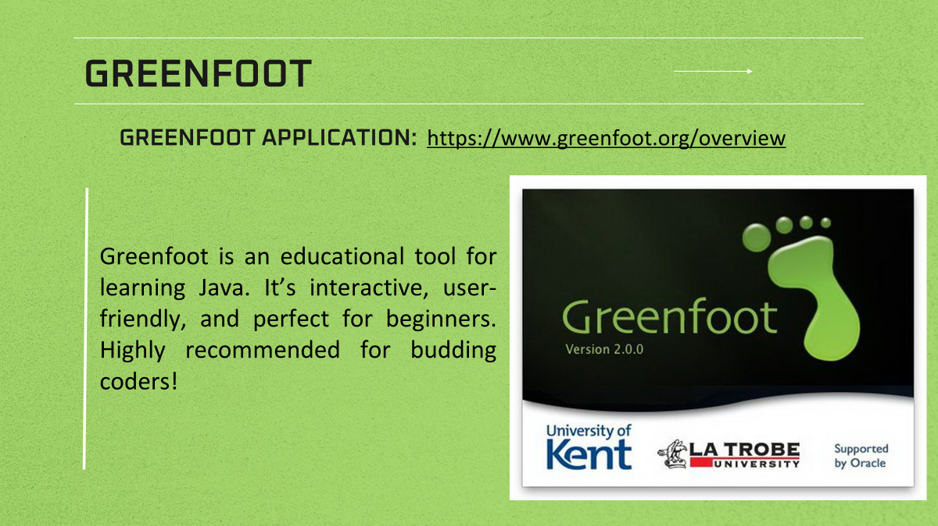

Slide 19

CONCLUSION

Slide 20
THANK YOU

